Slide 2

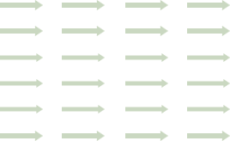
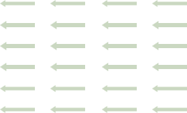

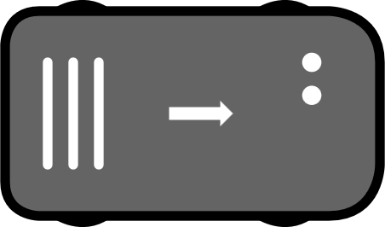
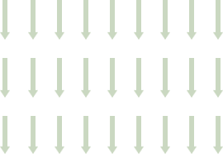
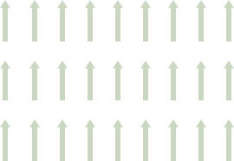

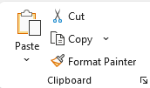
Coordinated Replanning
Zone
Obstacles
Action Zone
Speed Limit Zone
Release Zone
Back
to
Menu
Action
Speed Limit
Release
Coordinated Replanning
Obstacle
Obstacle
Line-Guided Zone
Blocked Zone
Priority Zone
Penalty Zone
Line-Guided
Blocked
Priority
Penalty
Corridor
Directed
Directed
Bidirected
Directed
Directed
“Copy + Paste” the zone and adjust size
Draw line and copy format with “Format Painter” or right-click on the line and “Set as standard”
If you draw non-rectangular zone use “Format Painter” button to transfer format for correct zone representation.
Double-click to format multiple objects

Slide 3


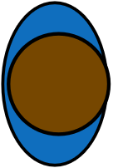


Mobile Robot
Action
Directed Path
Edge
Back
to
Menu
Node
Mobile Robot with bounding box
Person
Transfer Station
Node (with devRange)
Start
End
Charging Station
Point of Interest
If you draw your own path use “Format Painter” button to transfer format for uniform representation.
Double-click to format multiple objects

Slide 4
Directed
Directed
Directed
Directed
Priority
Penalty
Bidirected
Obstacle
Action
Speed Limit
Release
Line-Guided
Coordinated Replanning
Blocked

Slide 5
Directed
Directed
Directed
Directed
Priority
Penalty
Bidirected
Obstacle
Action
Speed Limit
Release
Line-Guided
Coordinated Replanning
Blocked

Slide 6
Directed
Directed
Directed
Directed
Priority
Penalty
Bidirected
Obstacle
Action
Speed Limit
Release
Line-Guided
Coordinated Replanning
Blocked

Slide 7
Directed
Directed
Directed
Directed
Priority
Penalty
Bidirected
Obstacle
Action
Speed Limit
Release
Line-Guided
Coordinated Replanning
Blocked

Slide 8
Directed
Directed
Directed
Directed
Priority
Penalty
Bidirected
Obstacle
Action
Speed Limit
Release
Line-Guided
Coordinated Replanning
Blocked

Slide 9
Directed
Directed
Directed
Directed
Priority
Penalty
Bidirected
Obstacle
Action
Speed Limit
Release
Line-Guided
Coordinated Replanning
Blocked

